Slide 1
Innovation starts with action! STEAM
Notes:
1

Slide 2
Innovation starts with action! STEAM
-What is STEAM?
Individual competencies in STEAM subjects (science, technology, engineering, arts and mathematics) are getting more important for the occupations of future which are based on high technology.
Notes:
2

Slide 3
Innovation starts with action! STEAM
-The curriculums not only in Turkey but also in other countries need to be revised because student motivation is not referred enough in STEAM subjects.
Notes:
3

Slide 4
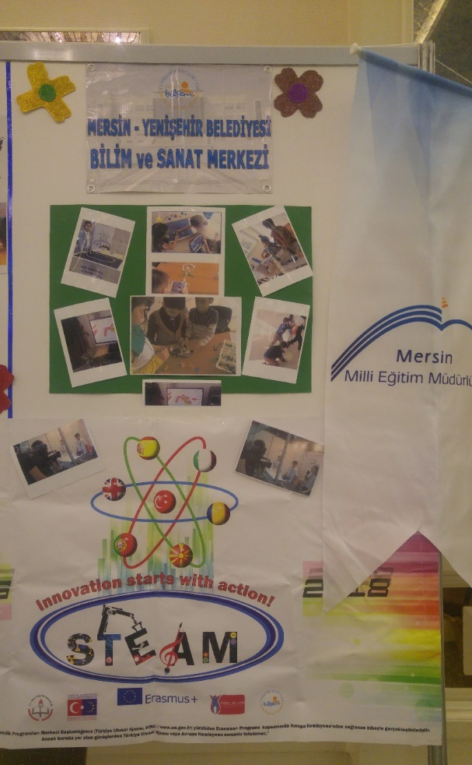
- 21st century skills such as;
digital skills,
critical thinking,
cooperation,
team spirit,
innovative and
analytical thinking are required.

Slide 5
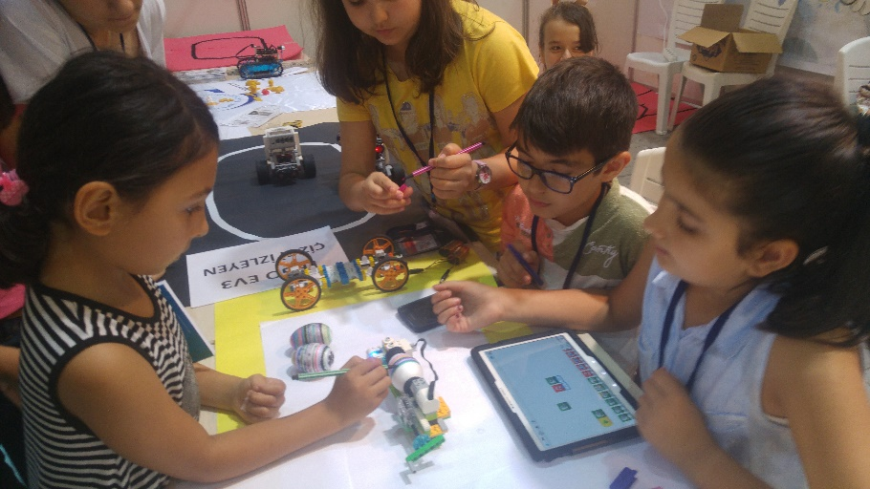
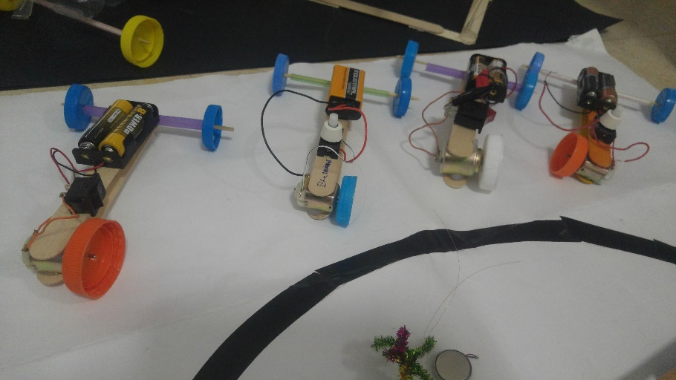
Students learn by doing together and they can solve problems if they have the opportunity to work in teams.

Slide 6
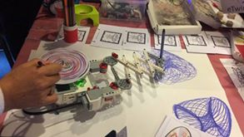
Robotics is one of the different materials in education to entergrate the different subjects .

Slide 7
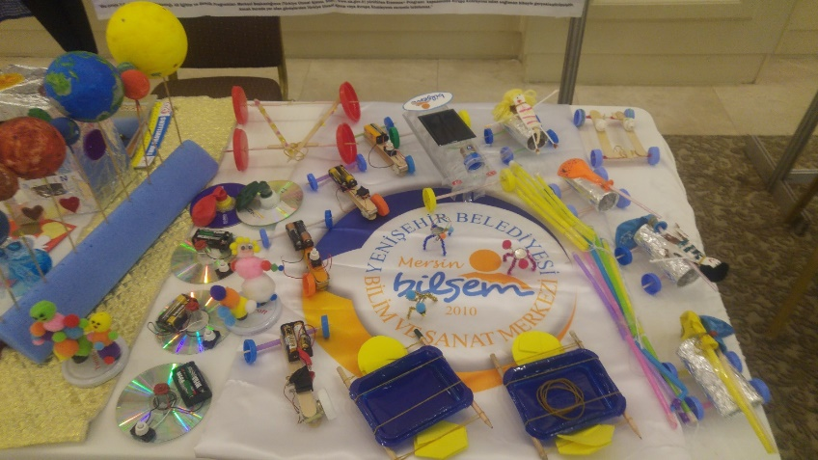
But we can use also a lot of an other waste materials to create and modelling the things in STEAM subjects.

Slide 8
References
Innovation starts with action! STEAM
http://hacettepestem33.weebly.com/
http://innovationsteam.weebly.com/

Slide 9
KANLIÖZ Yıldız
Primary school teacher in Science and Art Center
Project Expert of the Directorate National Education in Mersin
eTwinner
iTEC Ambassodor
Scientix Ambassodor
http://innovationsteam.weebly.com/
ykanlioz@hotmail.com
@ykanlioz
Yıldız Kanlıöz
@ykanlioz
ykanlioz
Yıldız Kanlıöz

